Slide 1


Open Data: Facing the Challenges
Sunil Choenni

Slide 2
Content
Introduction WODC
Challenges & Solution Directions
From Open Data to Semi-Open Data
2
Notes:
Titel
17 oktober 2012
Titel | 17 oktober 2012
2

Slide 3
Introduction
The WODC is a governmental criminal justice knowledge centre.
It aims to make a professional contribution to development and evaluation of justice policy set by the Dutch Ministry of Security and Justice.
Some of its tasks:
Advising how much and what kind of research is needed to answer policy-related questions.
Conducting in-house research and commissioning external research.
Systematically collecting, storing, enhancing and providing criminal justice information produced by external organizations.
3
Notes:
Titel
17 oktober 2012
Titel | 17 oktober 2012
3

Slide 4
Monitoring crime and law enforcement
To monitor crime and law enforcement, databases of several organizations, covering different parts of the criminal justice system, have to be integrated.
Combined data from different organizations may then be analyzed, for instance, to investigate how specific groups of suspects move through the system.
Such insight is needed for several reasons, for example, to identify potential problems or define an effective and coherent safety policy.
4

Slide 5
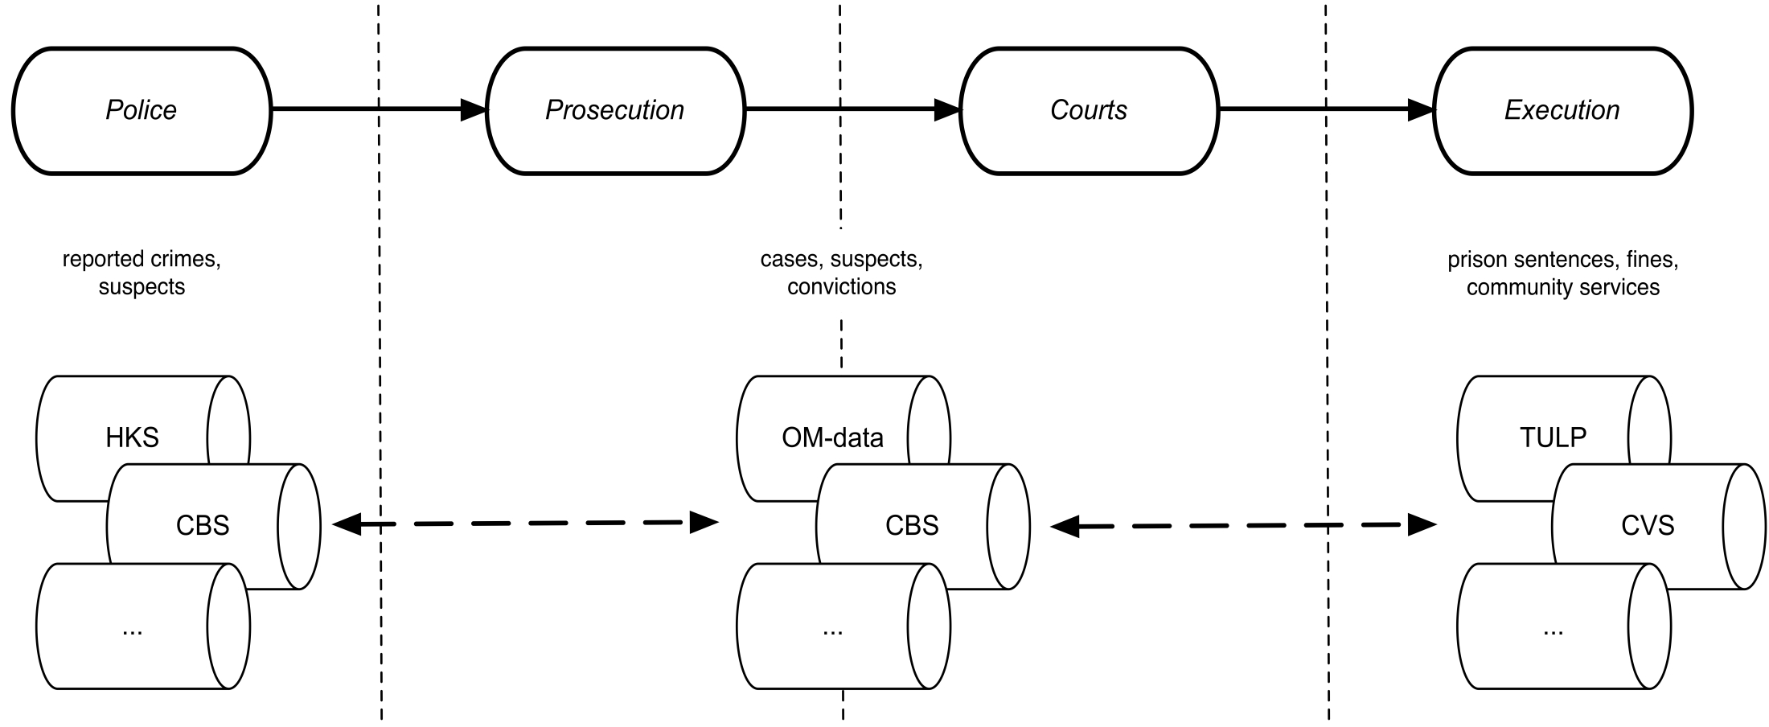

The Dutch criminal justice system
5

Slide 6
Open Data
Definition: “Open means anyone can freely access, use, modify, and share for any purpose (subject, at most, to requirements that preserve provenance and openness)”
Open Data objectives
Improving transparency of governments
Increasing accountability and compliance of governments
Supporting participatory governance by citizens
Supporting innovation by private sector
Improving efficiency/cost-effectiveness of public/private services
Supporting informed decisions by consumers, policymakers and businesses
Supporting evidence based research by scientists

Slide 7
Open Data characteristics
Ways of data access
Ease of access, without any registration and technological restrictions, via an API, via a web portal, free of or low charge
Data formats
Being machine-readable and process-able (e.g., CSV and XML)
Data content and types
Timely, as it is (as raw as possible), complete (as a bulk), in primacy, with metadata
Post release support
To remain online with permanent URIs, appropriate version tracking, archiving, and history logging over times

Slide 8
Open Data characteristics | Canada | USA | The NL | SOUTH AF.
For the public | ✓ | ✓ | ✓
License free and reusable | ✓ | ✓ | ✓ | ✓
Ease of access | ✓ |  | ✓ | ✓
Accessible via a web portal |  |  | ✓ | ✓
Free of charge | ✓ |  | ✓ | ✓
Machine-readable | ✓ |  | ✓ | ✓
Standard data formats | ✓ | ✓
Timely | ✓ | ✓ | ✓ | ✓
As it is |  |  | ✓
Complete | ✓ | ✓ | ✓ | ✓
Primacy | ✓ | ✓
With metadata |  | ✓ | ✓
With URLs |  |  |  | ✓
Permanence | ✓ |  | ✓ | ✓
No sensitive information | ✓ | ✓ | ✓ | ✓

Slide 9
Datasets opened by | Number
Ministry of Infrastructure and Environment | 1225
Ministry of Economic Affairs | 177
Diverse | 118
Ministry of Education, Culture and Science | 96
Ministry of the Interior and Kingdom Relations | 25
Ministry of Health, Welfare and Sport | 18
Ministry of General Affairs | 8
Ministry of Finance | 5
Ministry of Defense | 4
Ministry of Foreign Affairs / Ministry of Foreign Trade and Development | 2
Ministry of Social Affairs and Employment | 0
Ministry of Security and Justice | 0

Slide 10
Undesired side effects (in judicial settings)
Privacy breaches
Misinterpretation (especially with legacy databases)
Low added Value (datasets are not interoperable)
Low Data Quality
➔ Leading to counterproductive/undesired effects on citizens’ trust

Slide 11
Challenges
Privacy: disclosure of identity
Legacy Data Sets
Joining different Data Sets
Improving Data Quality

Slide 12
Privacy (1)
The more data is combined, the larger the chances on privacy violations
Suppose that a school publishes the average exam marks of students, split along boys and girls. If we know that only two girls take part to an exam and we are able to derive, e.g., from social media, that one of the girl has a 9, the result of the other is known as well.
Solution Direction: privacy by design
We consider privacy as a soft requirement of a system which should be kept in mind during the system lifecycle process

Slide 13
Publishing and Using Data III Privacy (2)
Only record attributes that are in line with the Dutch Personal Data Protection Act (no data about someone’s religion or life conviction, political conviction, health, sexual orientation, ethnic orgin)
Use and publish micro data with care; aggregate the data when the privacy of individuals may be at risk.
Whenever there is a chance of exposing the identity of an individual, selected data set should be masked or not (or only in part) shown. E.g., if there are only 2 convicted persons for a crime type X, this might disclose the identities. Also if there are 90 % of the people in a region involved in crime, this might stigmatized a group of people

Slide 14
Legacy (1)
Databases may contain large amounts of data that were collected and stored in the (distant) past.
Data may evolve over time as rules and regulations are changing, resulting in semantic changes.
Example:
Stored country of birth of an offender: USSR
Today USSR does not pertain to a real place
So, in the past DQ(country) was fine, today poor
−> DQ degradation

Slide 15
Legacy(2)
When legacy databases are used, the results obtained through analysis, (e.g.data mining) do not always hold in the real world of today
The results may hold for the past at the time the data was gathered
Many analysing techniques, including data mining, are based on induction, the results may be true given the data, but not in the real world
Results obtained by analysing data should be evaluated by experts in order to determine whether they hold in the real world of today.

Slide 16
Legacy Data(3)
Dataset about punishment imposed by courts for different crime types
“how often is a community service imposed for a sex offence?”
Answer led to political and ethical question (a high number of community services). Impression was provoked that punishment of this type of offences is not severe enough.
“how often is a community service in combination with an imprisonment imposed by court for a sex offence?”
Involvement/cooperation with database experts is required

Slide 17
Architectures (1)
Data Warehouse
Extract
DW
...
Cleaning
Transform
Load
Meta database
Data marts

Slide 18
Architectures(2)
Uniform view of your data
May be used for data mining and other analysis
Requires an enormous effort to set up a DW
- remove redundancy
- search for functional dependencies
- materialized data warehouse requires many joins (recall that a join is the most costly operation in query processing)

Slide 19
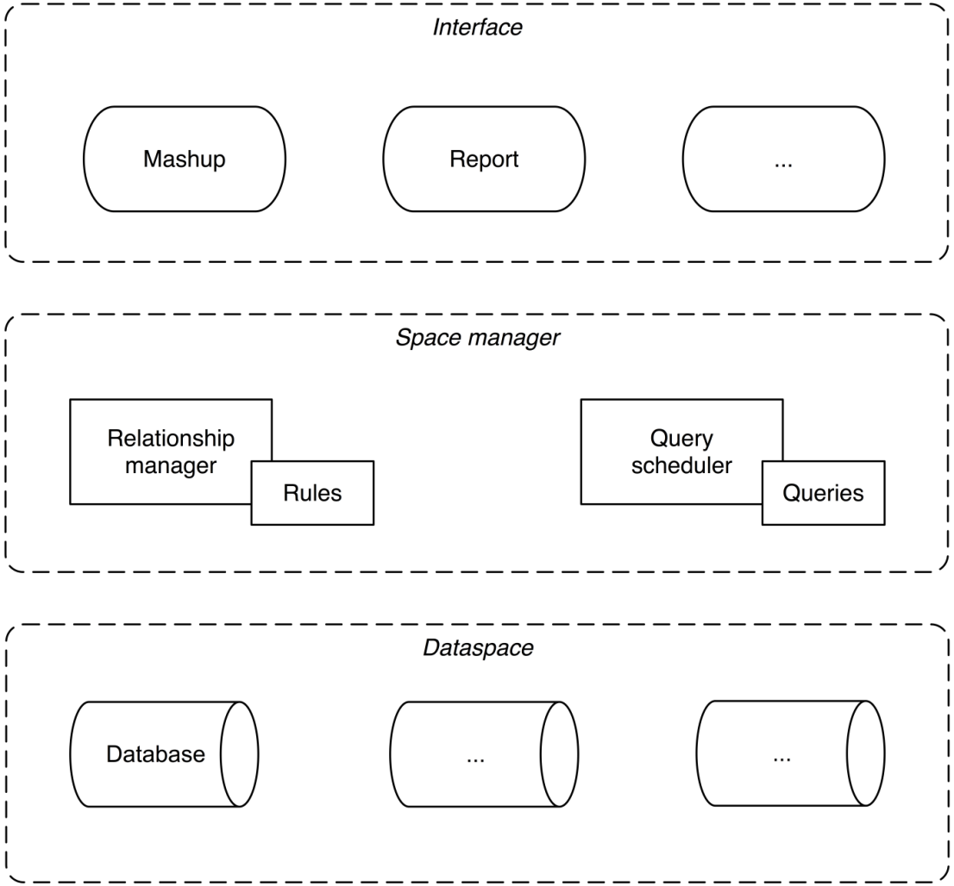
Architectures (3)

Slide 20
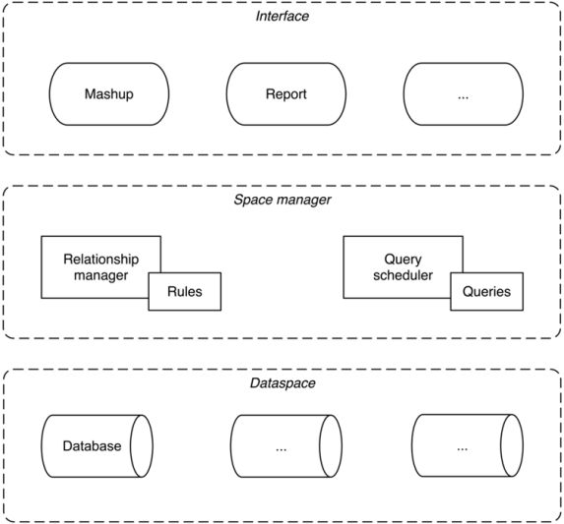
Architectures (4)
This approach distinguishes three layers:
The dataspace layer contains a set of (cleaned) databases that are complement to each other and may be related.
The space manager layer has two key tasks:
The relations that exist between these databases are stored in a relationship manager.
The query scheduler serves as a communicator between the databases and the user interface. As users define questions at the interface level, the query scheduler decides which databases to query in order to answer each question.
The interface layer allows the user to ask questions and displays the query results to the user. It contains mashups and reports.

Slide 21
Architectures (5): Design of the Monitor: Relationship Manager
Rules to handle similar data coming from different sources.
e.g. the number of community services comes from the public prosecutor and by the executing organization
# of comm. serv. PP >= # of comm. serv. exec. orgs
Rules to deal with missing data (that, for instance, allow for the imputation of missing values based on similar, correlated attributes).
e.g. date of committed crime = date crime reported to the police

Slide 22
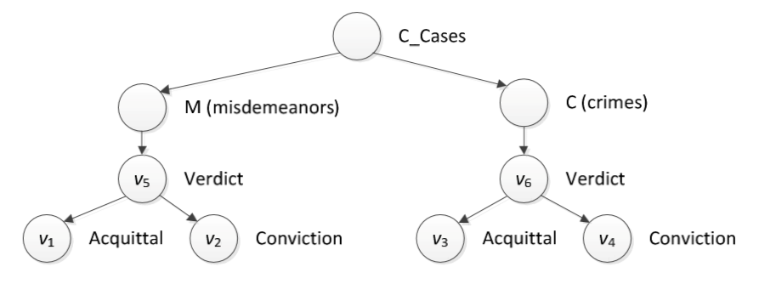
Architectures(7): Relationship Layer

Slide 23
Architectures(6)
The relations that exist between the to be integrated databases are stored in the relationship manager.
The relationship manager maintains data quality (the plausibility and consistency of the data) by providing rules to which the data must adhere.
Rules to handle similar data coming from different sources.
Rules to deal with missing data.
Rules to allow for incomplete or tentative data.
Rules to record semantic changes in attributes.
Rules to filter out results that should not be shown to the user.
Rules to determine whether large deviations exist between past and future data or between values from the same or different databases.

Slide 24
Open Data Paradox
On the one hand there are many obstacles to realize the goals of open data. And coming with feasible solutions for them (e.g interoperability of data) is really hard. Therefore, open data is not very beneficial for many organizations. Especially, small organizations are becoming less enthusiastic wrt open data.
On the other hand we observe also a growing interest wrt Open Data at government organizations.
(more organizations and citizens are appealing on the freedom of information act)
Too restrictive criteria/requirements of Open Data (our focus!)

Slide 25
Semi-Open Data
Motivations
Many data dissemination initiatives that do not comply with Open Data requirements but serve, to some degree, Open Data objectives
One should acknowledge those initiatives that push the frontiers of information sharing towards Open Data objectives
Encouragement of such initiatives
Realistic overview of such initiatives
Our suggestion
Not making a binary decision whether or not a data sharing initiative fulfills all conditions of Open Data
Adopting a multi-dimensional multi-level measurement framework to measure and quantify those initiatives

Slide 26
Semi-Open Data
Definition
Semi-Open Data refers to those data disclosure initiatives that partially satisfy the requirements of Open Data — i.e., anyone can freely access, use, modify, and share the data for any purpose subject, at most, to requirements that preserve provenance and openness — while certainly aim at achieving some objectives of Open Data — i.e., transparency, participation and collaboration.

Slide 27
Measure Semi-Open Data Initiatives
A multi-dimensional multi-level measurement framework
Dimensions can correspond to Open Data requirements
Per dimension define a number of ordinal levels
Assign appropriate number of units to the ordinal levels
Adopt an appropriate (distance) measure to determine a data opening initiative to the Open Data point

Slide 28
Semi-Open Data
Example
Dimension
“for the public”
Ordinal levels
‘share with no one’
‘share data within a specific group’
‘share data within a department of an organization’
‘share data within an organization /ministry’
‘share data among a federation of organizations’
‘share with the public’
Assign values to each level
Measure the distance to ideal Open Data point (see the next slide)

Slide 29
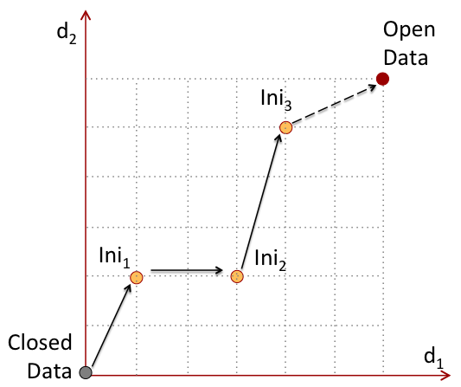
Measuring data opening initiatives
An illustration in a
2-dimensional space

Slide 30
Example
Dimension
Standard data format aspect,
Ordinal levels
‘without any specific data format’,
‘with a data format of acceptable convertibility’
‘with a data format of high/precise convertibility’
‘with a standardized data format’

Slide 31
Support the Use of Open Data
Opened data, but also
Meta data
Tools to analyse data
Guidelines how to choose and to apply tools to
answer different types of question;
guidelines to interpret results
Interaction platform for users (e.g., where they
may discuss quality issues of data sets, ..)
Recognize and appreciate the efforts of those
organizations behind semi-open data initiatives

Slide 32
P. Conradie, R. Choenni, On the barriers for local government releasing open data, GIQ Government Information Quarterly 31(Supplement 1), pp. S10-S17, Elsevier Press
Zuiderwijk, M. Janssen, R. Meijer, R. Choenni, Y. Charalabidis, K. Jeffery, Issues and Guiding Principles for Opening Governmental Judicial Research Data. Proc. EGOV 2012, 11th European Conf. On Electronic Government, Kristiansand, Norway, September 3-6, LNCS 7443, Springer verlag, Germany, pp. 90-101.
Zuiderwijk, M. Janssen, R. Choenni, R. Meijer, R. Sheikh Alibaks, Socio-technical Impediments of Open Data, EJEG, Electr. Journ. on E-Government 10(2), December 2012, pp. 156-172. http://www.ejeg.com/volume10/issue2/p156
R. Meijer, P. Conradie, R. Choenni, Reconciling Contradictions of Open Data Regarding Transparency, Privacy, Security and Trust, JTAER, Int. J. of Theoretical and Applied Electronic Commerce Research 9(3), pp. 32-44, Universidad de Talca, www.jtaer.com.
S. Kalidien, R. Choenni, R. Meijer, Crime Statistics On Line: Potentials and Challenges, Proc. DG.O 2010, 11th Annual Int. Conf. on Digital Government Research, Puebla, Mexico, May 17-20, ACM Press, pp. 131-137.
M. Shoae Bargh, R. Choenni, R. Meijer, Meeting Open Data Halfway: On Semi-Open Data Paradigm, Proc. ICEGOV 2016, 9th Int. Conf. on Theory and Practice of Electronic Government, Montevideo, Uruguay, March 1-3, ACM Press, USA, pp 199-206.
R. Choenni, M. Shoae Bargh, C. Roepan, R. Meijer, Privacy and Security in Smart Data Collection by Citizens, in Smarter as the New Urban Agenda: A Comprehensive View of the 21st Century City, Gil Garcia, J. Pardo, T., Nam, T., (eds), Springer, New York, USA,
M. Shoae Bargh, R. Choenni, R, Meijer, On Design and Deployment of Two Privacy-Preserving Procedures for Judicial-Data Dissemination, GIQ Government Information Quarterly 33(3), pp. 481-493, Elsevier Press.
S. van den Braak, R. Choenni, Development and use of data-centric information systems to support policymakers: applied to criminal justice systems, in Policy Analytics, Modelling, and Informatics: Innovative Tools for Solving Complex Social Problems, Gil Garcia, J., Pardo, T., Luna Reyes, L., (eds), Springer, New York, USA, to appear.
M. Shoae Bargh, R. Choenni, R, Meijer, On Addressing Privacy in Disseminating Judicial Data: Towards a Methodology, TGPPP, Transforming Government: People, Process and Policy x(y), 2016, pp., Emerald Group Publishing, accepted.
J. van Dijk, S. Kalidien, R. Choenni, Smart Monitoring of the Criminal Justice System, GIQ Government Information Quarterly, Elsevier Press,.

